Slide 1
FIT1045 Introduction to Algorithms and Programming Lecture 20 Complexity for Tree Algorithms
COMMONWEALTH OF AUSTRALIA
Copyright Regulations 1969
WARNING
This material has been reproduced and communicated to you by or on behalf of Monash University pursuant to Part VB of the Copyright Act 1968 (the Act).The material in this communication may be subject to copyright under the Act.Any further reproduction or communication of this material by you may be the subject of copyright protection under the Act.
Do not remove this notice.

Slide 2
Suppose the time complexity for an algorithm is 3N³ + 1000N² - 2000. Then in Big O notation the complexity is:
O(2000)
O(1000)
O(N²)
None of the above

Slide 3
A function g(n) is said to be O(f(n)) if there exist constants k and L such that ...
g(n) > k* f(n) for all n < L
g(n) < k*f(n) for all n < L
g(n) < k*f(n) for all n > L
None of the above

Slide 4
Overview
Terminology
Height of Balanced Binary Trees
Binary Search Trees
Heaps
Heap Sort

Slide 5
Level
Number of edges to the root node

Slide 6
Level
Number of edges along a path to the root node
Level 0
Level 1
Level 2
Level 3

Slide 7
Height
Maximum level in the graph

Slide 8
Height
Maximum level in the graph
Height = 4
Level 4

Slide 9
Binary Tree
Every node has at most two children. Every subtree is a Binary Tree
Note: Empty tree is also a binary tree

Slide 10
Balanced Binary Tree
For every node
|height(left subtree) – height(right subtree)| ≤ 1

Slide 11
Unbalanced Binary Tree

Slide 12
Prefect Binary Trees
N =1 Height = 0
N =3 Height = 1
N =7 Height = 2

Slide 13
The number of leaves in a perfect tree of height k is:
2^{k}
2^{k+1}
2^{k-1}
None of the above

Slide 14
N = 2^{(k+1)} -1 Height = k

Slide 15
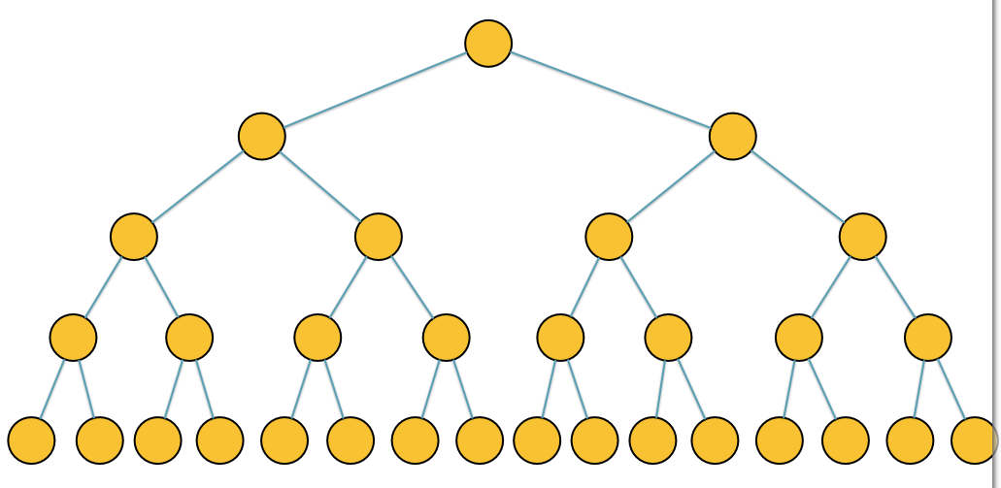
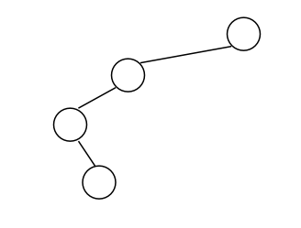
Important Relationships
Height = O(log(N))
Height = O(N)

Slide 16
Important Relationships
Balanced Trees
Height = O(log(N))
Unbalanced Trees
Height = O(N)

Slide 17
Binary Search Tree
For every node:
The values in the left subtree are less than value of the node.
The values in the right subtree are greater than value of the node.
12
8
18
3
10
20
15
5
9
13
16
Note: Every subtree is a Binary Search Tree
Notes:
Explain this definition.

Slide 18
If searching for an item stored at the root node, will you find it faster in a …
A) Balanced Tree
Height = O(log(N))
B) Unbalanced Tree
Height = O(N)

Slide 19
The worst case for searching for a target item in a binary search tree occurs when:
A) The target matches an item stored in a balanced tree
B) The target matches an item stored in a unbalanced tree
C) There is no item matching target and the tree is a balanced tree
D) There is no item matching target and the tree is an unbalanced tree

Slide 20
The worst time complexity for searching for an item in a Binary Search Tree is?
O(1)
O(N)
O(log(N))
None of the above

Slide 21
Search for an item in a Binary Search Tree
Best Case?
Worst Case?
Notes:
Describe how we insert a number in a Heap, and how we remove the minimum from the Heap.

Slide 22
Binary Search Tree
For every node:
The values in the left subtree are less than value of the node.
The values in the right subtree are greater than value of the node.
12
8
18
3
10
20
15
5
9
13
16
Note: Every subtree is a Binary Search Tree
Notes:
Explain this definition.

Slide 23
The worst time complexity for inserting an item into a Binary Search Tree is?
O(1)
O(N)
O(log(N))
None of the above

Slide 24
Insert item into a Binary Search Tree
Best Case?
Worst Case?
Notes:
Describe how we insert a number in a Heap, and how we remove the minimum from the Heap.

Slide 25
Heap (Min-Heap)
A tree is a heap if:
For every node:
The values of the children are greater than or equal to its value.
All the levels are filled, except possibly the last one, which is filled left to right.
2
8
5
12
10
6
8
20
15
19
23
9
Note: The minimum is always at the root of the tree.
Notes:
Explain this definition.

Slide 26
Heap (Max-Heap)
A tree is a heap if:
For every node:
The values of the children are less than or equal to its value.
All the levels are filled, except possibly the last one, which is filled left to right.
32
18
25
12
17
16
10
2
5
1
3
9
Note: The maximum is always at the root of the tree.
Notes:
Explain this definition.

Slide 27
Insert item into a min-Heap
Best Case?
Notes:
Describe how we insert a number in a Heap, and how we remove the minimum from the Heap.

Slide 28
The worst time complexity for inserting an item into a min-Heap is?
O(1)
O(N)
O(log(N))
None of the above

Slide 29
Insert item into a min-Heap
Worst Case?
Notes:
Describe how we insert a number in a Heap, and how we remove the minimum from the Heap.

Slide 30
Heap Sort
Add every item from a list to a heap
Keep taking the minimum off the heap

Slide 31
Inserting and Searching in Trees
Insertion - Find where to insert - Insert item - (For heap – ‘fix’ heap property after insertion)
Searching - Item in tree - Item not in tree
Balanced Trees and Unbalanced Trees
BST and Heaps
Sorting -- Heapsort

Slide 32
Reading: The Design and Analysis of Algorithms Chapter 2.2 Big - O notation
Moodle: Lots of interesting videos to watch.
Try: Insert these items [1,5,3,2,10] into:
A binary search tree Question – is it balanced?
A min-heap Create a sorted list by repeatedly removing minimum item from heap.

